Slide 1

DEFENCE SERVICES ACADEMY
M.C.Sc (21st Batch) Computer Science
DEPARTMENT OF COMPUTER SCIENCE
18.02.2025
Pyin Oo Lwin
Notes:
Good Morning! Honorable and invited guests, all of my Lecturers, supervisor and my batch friends.

Slide 2
IMPLEMENTATION OF AN AUTOMATED DYNAMIC WEAPON RANGE VISUALIZATION AND ENGAGAEMENT PLANNING FOR MILITARY TACTICAL SUPPORT SYSTEM USING GEOSPATIAL DATA
Presented by
Captain Aung Nyi Nyi Min
M.C.Sc (21st Batch)
Third Seminar
Supervisor Lt.Col Zar Nay Lin
Co-Supervisor Major Yar Zar Doe
Notes:
Firstly, May I introduce myself.
I'm Captain Aung Nyi Nyi min, and Master Candidate at Department of Computer Science.
Today I' would like to present my thesis work.
The title of my thesis is “IMPLEMENTATION OF AN AUTOMATED DYNAMIC WEAPON RANGE VISUALIZATION AND ENGAGAEMENT PLANNING FOR MILITARY TACTICAL SUPPORT SYSTEM USING GEOSPATIAL DATA” .
And my supervisor is Lt.Col Zar Nay Lin and my co-supervisor Major Yar Zar Doe .

Slide 3
Outlines
Abstract
Introduction
Aim of Thesis
Objectives of Thesis
Problem Statement
Background Theories
Implementation
Conclusion
3
Notes:
OK! First of all, I would like to present outlines of my thesis.
In this seminar, I will present our thesis as these program. And generally divided by 8 state.
First stage is the abstract of our thesis.
Second stage is the Introduction of our thesis.
Third stage is the Aim of our thesis.
Fourth stage is the Objectives of our thesis.
Fifth is the Problem Statement .
Sixth is the Scope of thesis and background theory.
Seven is the Implementation.
Finally, is the conclusion of our thesis.

Slide 4
Abstract
The system automates the process of mapping current and target locations, measuring distances, and visualizing weapon ranges based on their power and specifications.
The system integrates various APIs to retrieve real-time geolocation data and converts geographic coordinates to the Military Grid Reference System (MGRS) for accurate positioning.
The system calculates the distance from the current location to the desired target, visualizes the effective firing ranges on interactive maps, and identifies the optimal troops and weapons for engagement based on proximity and ammunition requirements.
Notes:
In this slides, May I present about the abstract of my thesis.

Slide 5
Introduction
In the realm of modern warfare, the precision and efficiency of tactical operations are paramount to mission success.
Traditional methods of planning and executing tactical operations are often time-consuming and prone to human error, necessitating the development of automated systems that can enhance decision-making processes.
The system supports the ability to quickly and accurately determine the positioning of forces, calculate engagement ranges, and optimize resource allocation can significantly impact the outcome of military engagements.
Notes:
Now I would like to present the introduction of system.

Slide 6
Problem Statement
In modern military, effective tactical planning and resource allocation are critical for mission success and minimizing collateral damage.
The current methods of tactical planning are time-consuming, prone to human error, and lack the agility required for real-time decision-making.
The absence of automated optimization algorithms in planning systems leads to suboptimal deployment of weapon systems.
This thesis aims to develop an Automated TDSS that integrates real-time geospatial data, advanced algorithms, and intuitive visualizations to enhance tactical planning.
Notes:
And then I would like to present the problem statement of system.

Slide 7
Motivation
Modern military operations are increasingly conducted in complex and dynamic environments, where success depends on the ability to make informed and timely decisions.
Traditional methods of tactical planning and weapon deployment, rooted in static maps and manual calculations, are no longer sufficient to address the multifaceted challenges of contemporary battlefields.
Modern warfare emphasizes minimizing collateral damage, ensuring operational precision, and adapting rapidly to unpredictable conditions.
By automating weapon range visualization and engagement planning, this work seeks to reduce human error, enhance safety, and support scalable solutions applicable across diverse scenarios such as disaster response and homeland security.
Notes:
And then I would like to present the problem statement of system.

Slide 8
Aim of My Thesis
The aim of this thesis is to develop an automated system for dynamic weapon range visualization and engagement planning that leverages geospatial data and advanced computational techniques to enhance military tactical decision-making and operational efficiency.
Notes:
Now I would like to present the Aim of my thesis

Slide 9
Objectives
To develop a geospatial data processing framework integrating multiple military and geospatial data sources for real-time tactical decision-making
To design an automated weapon range visualization tool that dynamically adjusts weapon engagement zones based on weapon specifications and range
To implement an intelligent engagement planning module for optimal weapon selection based on target distance, inventory, and mission parameters
To develop an interactive battlefield mapping system for plotting force positions, defining operational areas, and generating tactical scenarios
To integrate an obstacle-aware route optimization module using heuristic pathfinding for troop movement planning and threat avoidance
To establish a strategic decision-support system using Lanchester’s Square Law to assess force comparisons, predict battle outcomes, and prioritize enemy targets
Notes:
And then I would like to present the objectives of our thesis.

Slide 10
Background Theory
Flutter
Geospatial Information Systems (GIS)
Military Grid Reference System (MGRS)
Map Caching for Online and Offline Use
Latitude/Longitude to MGRS Conversion
Tactical Decision Support System (TDSS)
Find Suitable Weapons Using Euclidean Distance
A* Algorithm and Barrier Avoidance
Heuristic Function
Lanchester’s Square Law for decision making Feedback
Notes:
In this slide, I would like to present the background thoery of system.

Slide 11
Flutter
Flutter is an open-source UI software development kit created by Google that enables developers to build natively compiled applications for mobile, web, and desktop from a single codebase.
Initially developed for Android and iOS app development, Flutter has quickly gained popularity due to its performance, flexibility, and ease of use.
Flutter uses the Dart programming language, which is optimized for fast development and high performance.
The framework’s standout feature is its ability to compile directly to native code, allowing it to offer performance similar to that of native Android applications.

Slide 12
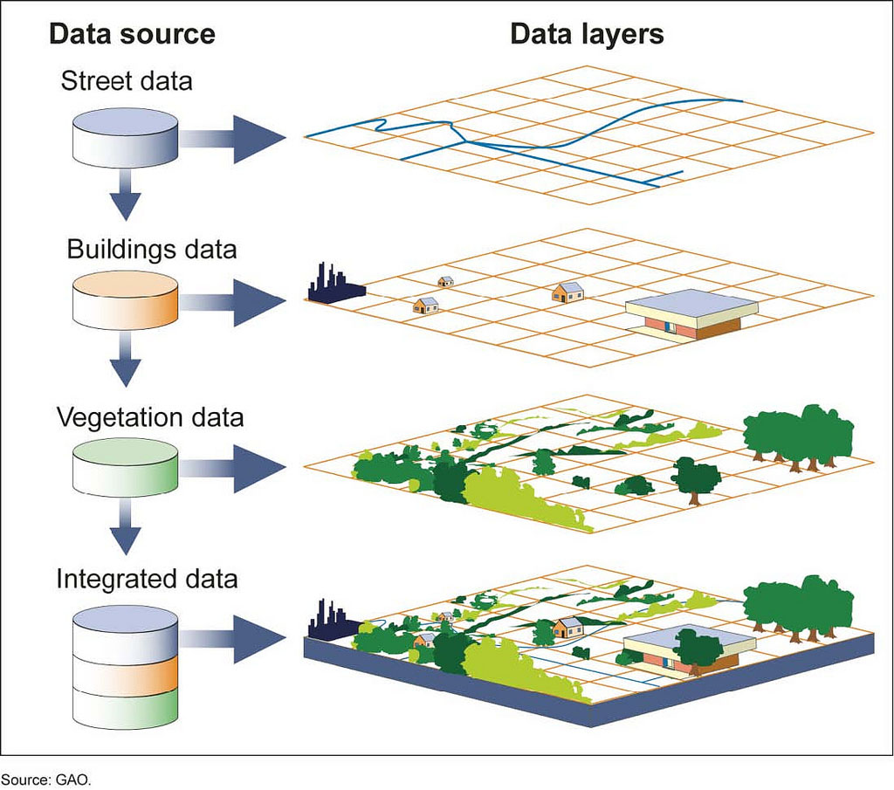
Geospatial Information Systems (GIS)
Geospatial Information Systems (GIS) represent a pivotal technology in the realm of spatial data management and analysis.
GIS integrates hardware, software, and data for capturing, managing, analyzing, and displaying all forms of geographically referenced information.
This technology has become indispensable across various disciplines, including urban planning, environmental management, logistics, epidemiology, natural resource management, and of course, military operations.

Slide 13
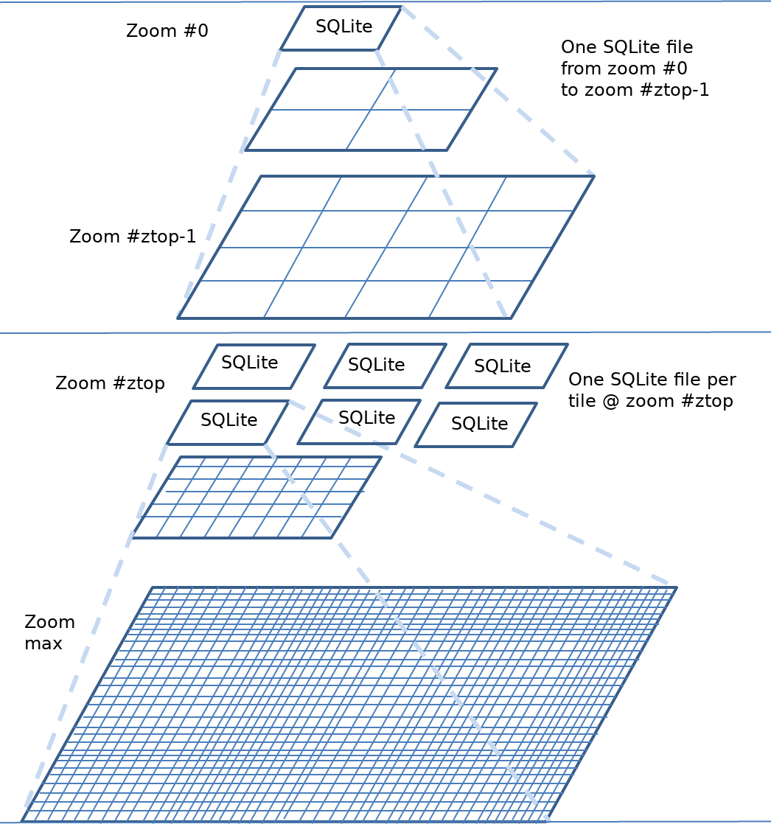
Map Caching for Online and Offline Use
A caching mechanism can be employed to locally store map tiles once they are download, enabling the system to use these cached resources when connectivity is lost.

Slide 14
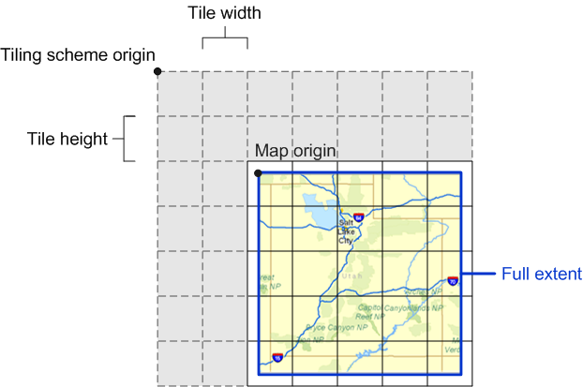
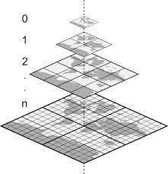
Map Caching for Online and Offline Use (Cont’d)
Procedure of map tiles cache solution
Tiles Provider Customization (getImage)
Dynamic URL Generation (getTileUrl)
Custom Image Provider (loadImage or _loadsyns)
Handling Online and Offline Mode

Slide 15
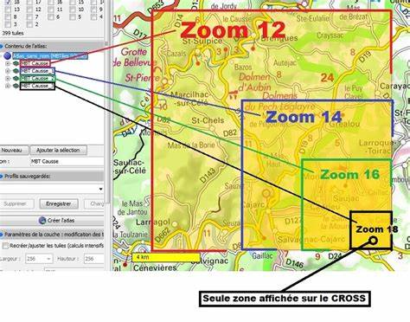
MBTiles Format for UTM Display
The key aspects of MBTiles include:
Tile Storage: It organizes tiles in a database structure, allowing quick access and efficient storage.
Offline Capabilities: By storing all map data in a single file, MBTiles provides developers with the ability to offer offline maps.
Versatile Data Types: MBTiles can store both raster images (like JPEG and PNG) and vector data (like GeoJSON), making it a flexible solution for diverse mapping needs.

Slide 16
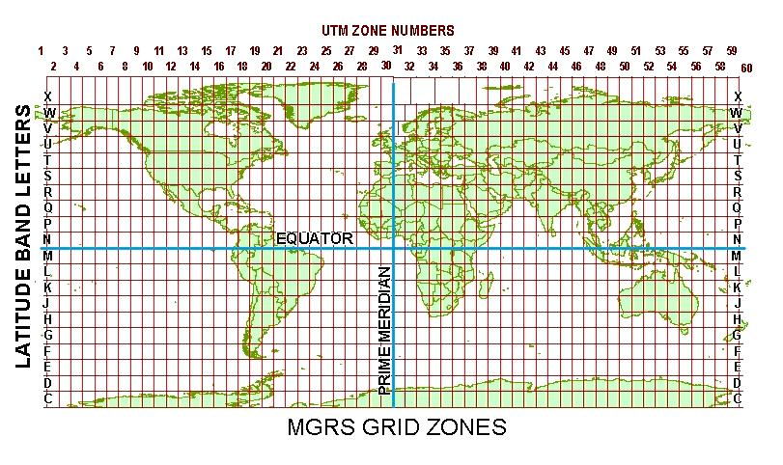
Military Grid Reference System (MGRS)
The Military Grid Reference System (MGRS) is a geographic coordinate system used extensively by military forces worldwide for locating points on the Earth's surface.
It is based on the Universal Transverse Mercator (UTM) coordinate system but provides a more concise and standardized method of representing geographic coordinates.

Slide 17
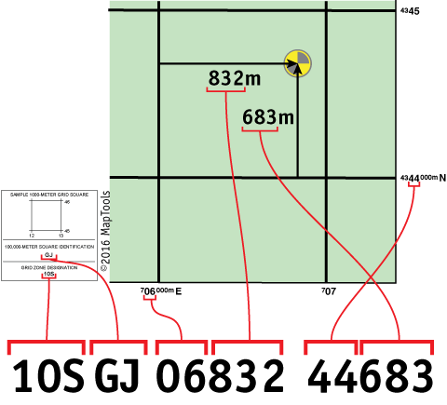
Latitude/Longitude to MGRS Conversion
The conversion from LatLng (latitude, longitude) to MGRS involves several steps, including:
Convert LatLng to UTM (Universal Transverse Mercator) coordinates
Determine the UTM zone
Convert UTM to MGRS

Slide 18
Algorithm Lat/Long to MGRS Conversion
Validate Latitude
Ensure lat is between -80° and 84°.
Zone and Meridian Calculation
Calculate Zone Number: (lon + 180) / 6.
Determine Central Meridian for the zone.
Convert Coordinates
Latitude/Longitude → Radians.
Compute trigonometric values (sin, cos, tan).
UTM Calculations
Easting (x): Adjusted with false easting (+500,000).
Northing (y): Adjusted with false northing (if in Southern Hemisphere).
Grid Square Letters
Determine Zone Letter based on latitude.
Compute 100k Easting (e100k) and Northing (n100k) letters.
Precision Adjustment
Extract 5-digit precision for Easting and Northing.
Construct MGRS String
Combine: ZoneNumber + ZoneLetter + GridLetters + Easting + Northing.
Output: MGRS coordinate string (e.g., 47Q KE 36177 31969).

Slide 19

Tactical Decision Support System (TDSS)
A Tactical Decision Support System (TDSS) is a specialized software application designed to assist military commanders and decision-makers in making informed decisions during tactical operations.
It integrates various data sources, analytical tools, and visualization techniques to provide real-time situational awareness and actionable insights.

Slide 20
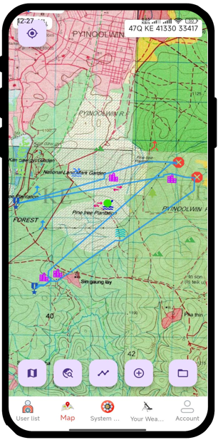
Key Components of TDSS
Data Integration and Fusion
Geospatial Analysis
Simulation and Modeling
Real-Time Decision Support
User Interface and Visualization

Slide 21
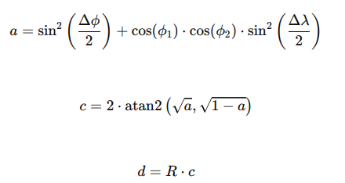
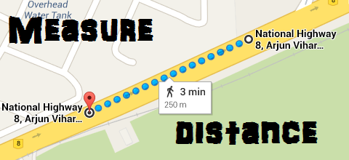
Distance Calculation From One Place To Another
Distance Calculation: Here use Haversine Formula to calculate distance.
Where:
ϕ1​,ϕ2​: Latitudes of the two points
Δϕ, Δλ: Differences in latitude and longitude between the points
R: Radius of the Earth (mean radius = 6,371 km)
d is the distance between the two points along the surface of the sphere.

Slide 22
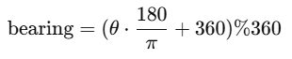
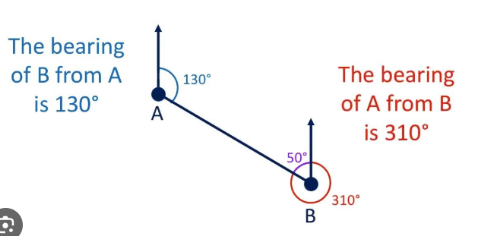
Distance Bearing From One Place To Another
Distance Bearing: The formula for bearing calculation is as follows.
Where:
ϕ1, ϕ2 ​: Latitudes of the two points (in radians).
Δλ: Difference in longitudes (λ2−λ1 ​, in radians).
θ: The calculated bearing in radians.
Finally, the result is converted to degrees and normalized to a range of 0∘ to 360∘ using:

Slide 23
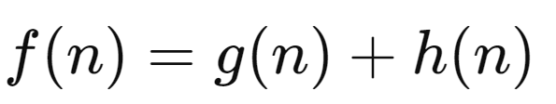
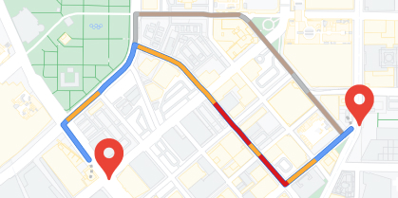
Route Planning For One Place To Another
Route Planning : Here use A Algorithm (A-star) to calculate Route Planning.
Where:
f(n): Estimated total cost of path through node n
g(n): Cost to reach node n
h(n): Estimated cost from n to the goal based on heuristic

Slide 24
Weapon’s Range Specification for Each weapon
Type | Gun Power | Min- Range (m) | Max- Range (m) | Min- Mils (mils) | Max- Mils (mils) | Min- Times (s) | Max- Times (s)
MA-7 | 0 | 250 | 750 | 1427 | 800 | 18.3 | 13.1
 | 1 | 500 | 1550 | 1437 | 800 | 25.3 | 18.2
 | 2 | 800 | 2150 | 1408 | 952 | 25.9 | 18.6
 | 3 | 1000 | 2900 | 1421 | 800 | 40.2 | 18.8
 | 4 | 1300 | 3480 | 1405 | 800 | 46.1 | 33.1
 | 5 | 1600 | 4050 | 1395 | 800 | 51.5 | 37.2
 | 6 | 1800 | 4600 | 1395 | 800 | 57.0 | 41
MA-8 | 0 | 200 | 550 | 1410 | 800 | 14 | 10
 | 1 | 400 | 1125 | 1414 | 800 | 21 | 15.1
 | 2 | 600 | 1650 | 1410 | 800 | 27.2 | 17.6
 | 3 | 900 | 2700 | 1427 | 800 | 36.4 | 26.1
 | 4 | 1300 | 3550 | 1409 | 800 | 44.2 | 35.0

Slide 25
Weapon’s Range Specification (Cont’d)
Type | Gun Power | Min- Range (m) | Max- Range (m) | Min- Mils (mils) | Max- Mils (mils) | Min- Times (s) | Max- Times (s)
MA-8 | 5 | 1600 | 4400 | 1412 | 868 | 51.1 | 39.1
 | 6 | 2100 | 5150 | 1387 | 800 | 57.8 | 41.8
 | 7 | 2400 | 5800 | 1382 | 800 | 62.9 | 45.5
 | 8 | 2400 | 6250 | 1402 | 800 | 68.6 | 49.4
MA-6 120 MM | 1 | 600 | 1850 | 1432 | 800 | 27 | 19
 | 2 | 1000 | 3000 | 1427 | 800 | 36 | 26
 | 3 | 1400 | 4100 | 1423 | 800 | 43 | 29
 | 4 | 1900 | 5250 | 1411 | 800 | 51 | 37
 | 5 | 2300 | 6100 | 1403 | 800 | 56 | 41
 | 6 | 2600 | 7000 | 1398 | 800 | 61 | 45
 | 7 | 2900 | 7650 | 1399 | 800 | 69 | 49
 | 8 | 3200 | 8150 | 1395 | 800 | 74 | 53
 | 9 | 3200 | 8500 | 1403 | 800 | 80 | 57
Notes:
Total data 1254 ခုရှိပါတယ်

Slide 26
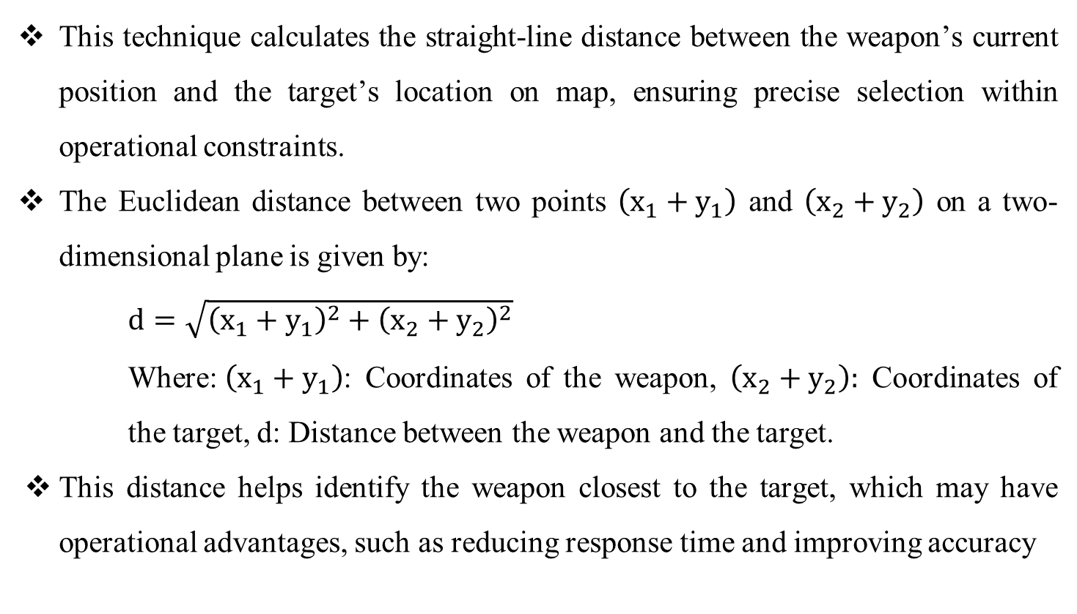
Find Suitable Weapons Using Euclidean Distance
This technique calculates the straight-line distance between the weapon’s current position and the target’s location on map, ensuring precise selection within operational constraints.
The Euclidean distance between two points $\left(x_{1}+y_{1}\right)$ and $\left(x_{2}+y_{2}\right)$ on a two-dimensional plane is given by:
$d=\sqrt{{\left(x_{1}+y_{1}\right)}^{2}+{\left(x_{2}+y_{2}\right)}^{2}}$
Where:$\left(x_{1}+y_{1}\right)$: Coordinates of the weapon, $\left(x_{2}+y_{2}\right):$ Coordinates of the target, d: Distance between the weapon and the target.
This distance helps identify the weapon closest to the target, which may have operational advantages, such as reducing response time and improving accuracy

Slide 27
The Most Suitable Weapon Selection
Blast Radius (20% Impact): Blast radius determines a weapon's area of effect (AoE), directly influencing its ability to damage multiple targets simultaneously.
Weapon Amount (10% Impact): The number of available units of a weapon contributes to operational readiness and redundancy.
Ammo Amount (60% Impact): A weapon's ammo capacity is given the highest weight due to its direct influence on sustained combat performance.
Rate of Fire (10% Impact): While the rate of fire contributes to damage output, it must be balanced against ammo consumption. Higher firing rates can deplete ammo rapidly, potentially limiting long-term effectiveness.
Balanced Scoring Formula: The following formula integrates these weighted factors to calculate the weapon's effectiveness:
Score = (GunPower + FlightTime + Mil)/ (0.1 × Rate of Fire × ((0.2 × Blast Radius) + (0.1 × Weapon Amount) + (0.6 × Ammo Amount)))

Slide 28
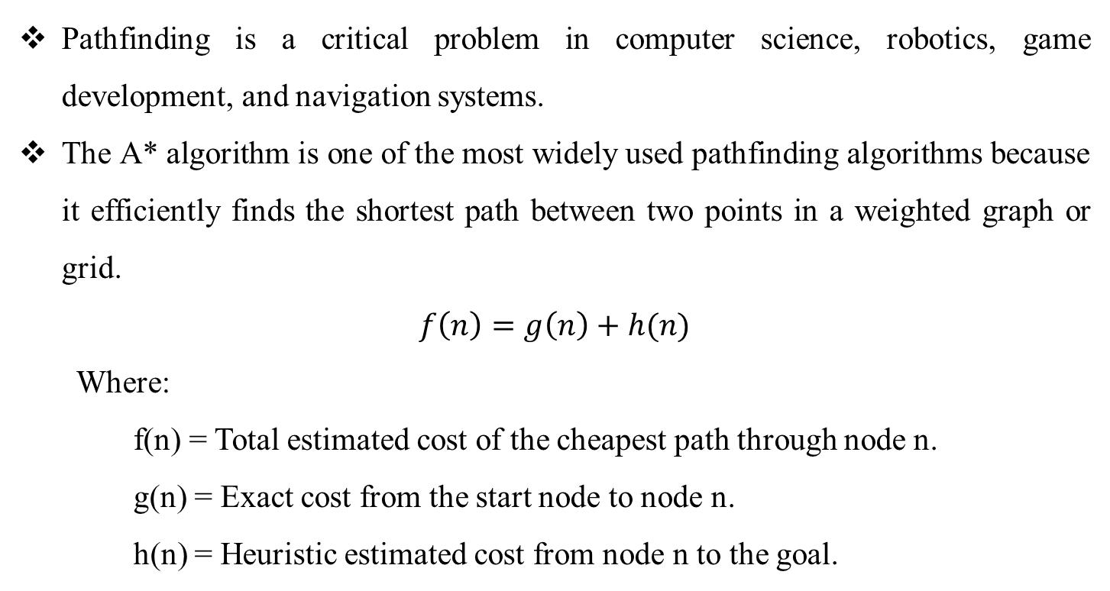
Pathfinding with A* Algorithm and Barrier Avoidance
Pathfinding is a critical problem in computer science, robotics, game development, and navigation systems.
The A* algorithm is one of the most widely used pathfinding algorithms because it efficiently finds the shortest path between two points in a weighted graph or grid.
$$f\left(n\right)=g\left(n\right)+h(n)$$
Where:
f(n) = Total estimated cost of the cheapest path through node n.
g(n) = Exact cost from the start node to node n.
h(n) = Heuristic estimated cost from node n to the goal.

Slide 29
Barrier Avoidance in A*
To navigate around barrier, the search space is divided into a grid where each cell represents a section of the map. Cells are classified as either passable (0) or impassable (1).
Barrier Representation:
Static barriers: Buildings, mountains, lakes (always impassable).
Dynamic barriers: Rivers with bridges (conditionally passable).
Expanded barriers: Obstacles are expanded to simulate their area of influence.
Barrier Handling in A*:
Neighbors in impassable cells are ignored during path evaluation.
Bridges or special paths are modeled to allow selective movement.
Grid Representation: 0=Passable,1= Barrier

Slide 30
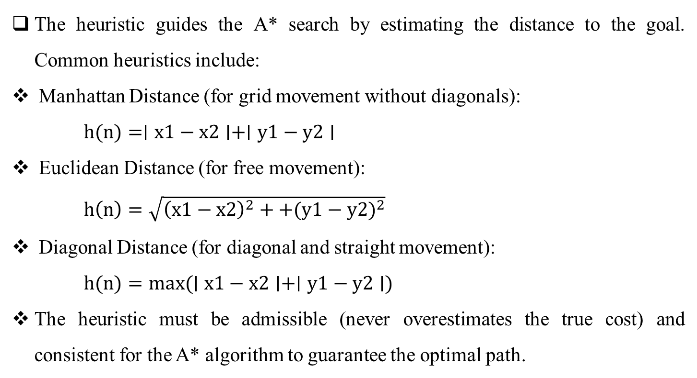
Heuristic Function
The heuristic guides the A* search by estimating the distance to the goal. Common heuristics include:
Manhattan Distance (for grid movement without diagonals):
$h(n)=∣x1−x2∣+∣y1−y2∣$
Euclidean Distance (for free movement):
$h\left(n\right)=\sqrt{{\left(x1−x2\right)}^{2}++{(y1−y2)}^{2}}$
Diagonal Distance (for diagonal and straight movement):
$h(n)=max(∣x1−x2∣+∣y1−y2∣)$
The heuristic must be admissible (never overestimates the true cost) and consistent for the A* algorithm to guarantee the optimal path.

Slide 31
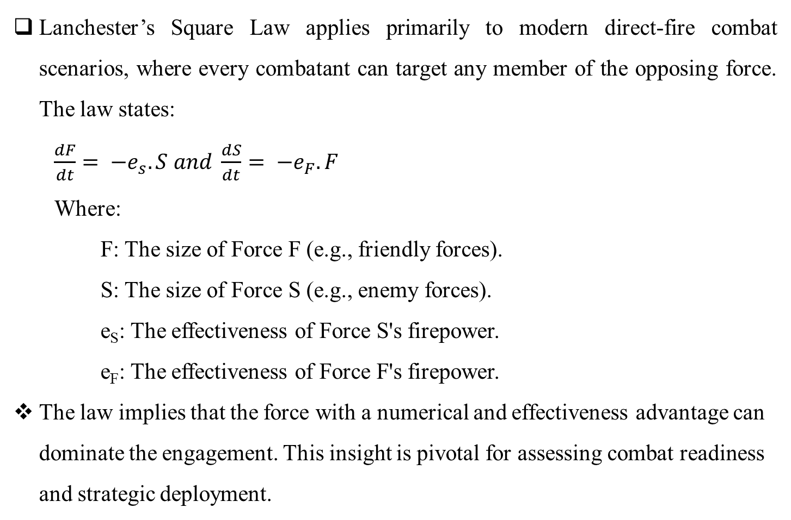
Lanchester’s Square Law for decision making Feedback
Lanchester’s Square Law applies primarily to modern direct-fire combat scenarios, where every combatant can target any member of the opposing force. The law states:
$\frac{dF}{dt}= −e_{s}.S and \frac{dS}{dt}= −e_{F}.F$
Where:
F: The size of Force F (e.g., friendly forces).
S: The size of Force S (e.g., enemy forces).
e_{S}​: The effectiveness of Force S's firepower.
e_{F}​: The effectiveness of Force F's firepower.
The law implies that the force with a numerical and effectiveness advantage can dominate the engagement. This insight is pivotal for assessing combat readiness and strategic deployment.

Slide 32
Literature Review
No | Title | Publisher & Year | Method | Issue
1 | Applications of Geographic Information Systems (GIS) in Military Operations | El-Gohary, M., & El-Rabbany (2011) | GIS | Their work emphasized how GIS enables real-time data visualization, precise location tracking, and effective resource allocation in complex operational environments. The study underlined applications such as terrain analysis, mission planning, and logistics management, demonstrating the technology’s capacity to provide commanders with actionable insights.
2 | Transverse Mercator with an accuracy of a few nanometers. Journal of Geodesy | Karney, C. F. F | GIS | Their work provided significant improvements over traditional methods, making it particularly useful for geodesy and cartography applications where accuracy is critical. By addressing computational inefficiencies and errors inherent in earlier models, the study offered a robust framework for mapping

Slide 33
Literature Review (Cont’d)
No | Title | Publisher & Year | Method | Issue
3 | The Role of Tactical Decision Support Systems in Modern Warfare | Hale, M., & Davis, R. (2020) | TDSS | The study explores key features of TDSS, such as situational awareness, resource optimization, and scenario simulation, demonstrating their effectiveness in improving tactical outcomes. Furthermore, the authors discuss the challenges of integrating TDSS into existing military frameworks, including issues related to interoperability, data reliability, and user training. This research underscores the importance of TDSS in contemporary defense strategies, advocating for continued advancements to meet evolving battlefield demands.

Slide 34
Literature Review (Cont’d)
No | Title | Publisher & Year | Method | Issue
4 | Applications of Distance Measurement in Military Targeting | Sharma, R., & Aggarwal, S (2020) | geospatial science & military operational theory | They explore the critical role of distance measurement in military targeting, emphasizing its applications in enhancing precision, efficiency, and strategic decision-making. The authors review various geospatial technologies and methodologies employed to calculate distances for targeting purposes, including GPS, laser rangefinders, and advanced satellite imaging. They discuss how accurate distance estimation improves weapon deployment, minimizes collateral damage, and supports tactical planning. The article underscores the growing importance of geospatial science in modern warfare and its impact on operational success.

Slide 35
Literature Review (Cont’d)
No | Title | Publisher & Year | Method | Issue
5 | The Calculus of Conventional War: Dynamic Analysis Without Lanchester Theory | Epstein, J. M. (1985) | Lanchester Theory | They critically examines traditional models of combat, specifically challenging the applicability of Lanchester’s equations for analyzing conventional warfare. Epstein argues that Lanchester’s deterministic models, which primarily focus on force-on-force attrition, oversimplify the complex dynamics of real-world combat by neglecting critical factors such as terrain, force dispersal, logistics, morale, and command structures.
6 | A Formal Basis for the Heuristic Determination of Minimum Cost Paths | Hart, P. E., Nilsson, N. J., & Raphael, B. | A* Algorithm & Heuristic Function | They introduced the A* (A-Star) algorithm, a groundbreaking approach to pathfinding and graph traversal. The A* algorithm effectively combines the strengths of Dijkstra's algorithm, which guarantees the shortest path by considering the exact cost from the start node, and the Greedy Best-First Search, which prioritizes nodes based on their estimated cost to the goal.

Slide 36

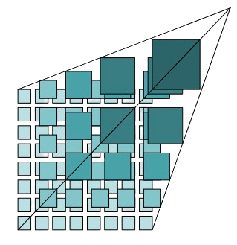



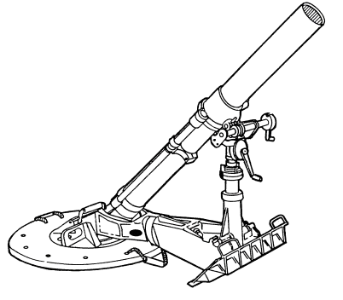
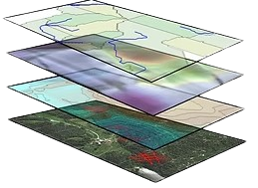


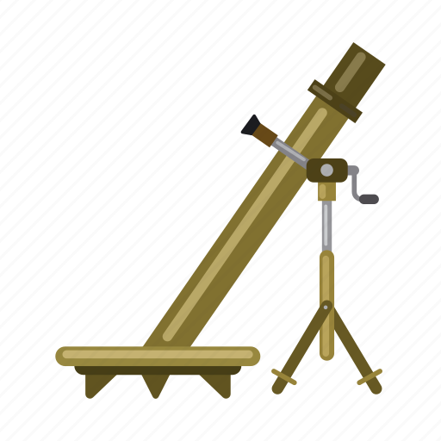

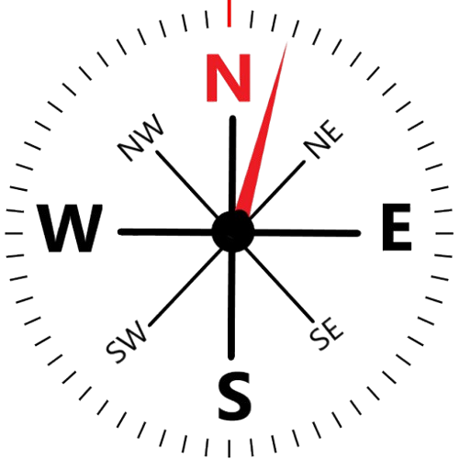




Proposed System Architecture
Map Tiles With Zoom Level
UTM Map From Storage
Locations And Barriers Data
Weapon Firing Data
My Weapon Data
Distance and Bearing Calculation
Weapon Firing Data
Create Operation Data
Pathfinding
TDSS Result and Feedback

Slide 37
Overall Design of the System

Slide 38
Detail Design for Admin

Slide 39
Detail Design for User

Slide 40
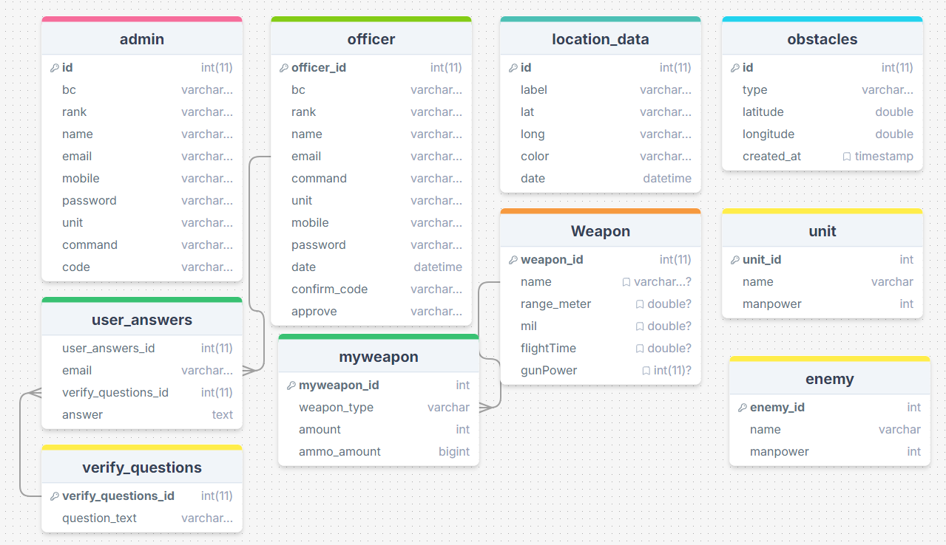
Proposed System Design for Database

Slide 41
Selection The Most Suitable Weapon
Weapon Data: The weapon details are summarized as follows:
Weapon | Gun Power | Flight Time | Mil | Blast Radius | Rate of Fire | Weapon Amount | Ammo Amount
MA7 | 200 | 5 | 10 | 15.0 | 18 | 5 | 150
MA8 | 250 | 6 | 12 | 35.0 | 20 | 3 | 100
120MM | 300 | 8 | 15 | 100.0 | 10 | 2 | 50
Scoring Formula: The scoring formula integrates weighted importance factors to calculate the overall effectiveness of each weapon:
Score = (GunPower + FlightTime + Mil)/ (0.1 × Rate of Fire × ((0.2 × Blast Radius) + (0.1 × Weapon Amount) + (0.6 × Ammo Amount)))
(c) Calculations
MA7:
Score_{MA7}=200+5+100.1×18×(0.2×15+0.1×5+0.6×150) ≈1.27
MA8:
Score_{MA8}=200+6+120.1×20×(0.2×35+0.1×3+0.6×100) ≈1.99

Slide 42
Selection The Most Suitable Weapon (Cont’d)
120MM:
Score_{120mm}=300+8+150.1×10×(0.2×100+0.1×2+0.6×50) ≈ 6.44
Results and Selection: Based on the calculations:
MA7: Score = 1.27
MA8: Score = 1.99
120MM: Score = 6.44
The weapon 120MM is determined to be the most suitable option due to its highest score of 6.44, indicating superior overall effectiveness. This selection reflects its excellent balance of firepower, sustained operational capability (ammunition availability), and strategic adaptability, making it ideal for the given combat scenario.

Slide 43


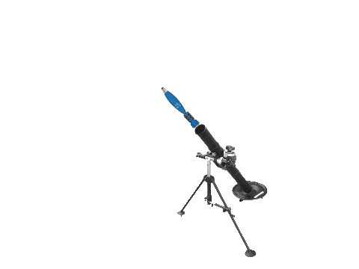
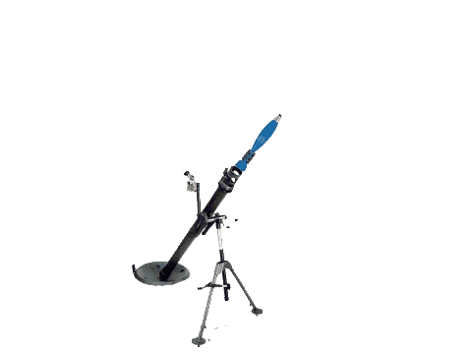









Symbols used on map
Symbols | Name
 | မိမိတပ်
 | ရန်သူ
 | ၆၀ မမ စိန်ပြောင်း
 | ၈၀ မမ စိန်ပြောင်း
 | ၁၂၀ မမ စိန်ပြောင်း
 | အဆောက်အဦ
 | ရေကူးကန်
 | တံတား
 | မြစ်
 | ချောင်း
 | ရေကန် ၊ အင်း
 | တောင်
 | ကုန်းမြင့်

Slide 44

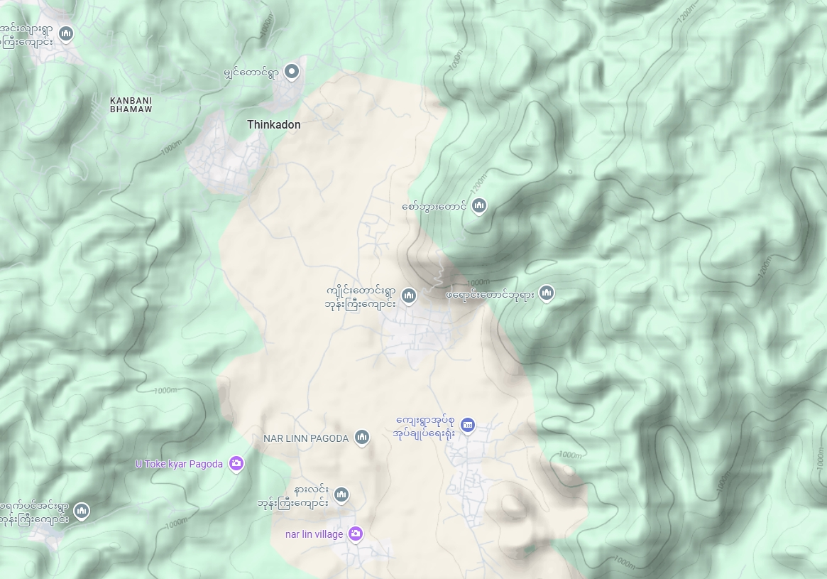
Sample TDSS Simulation
My Weapon Data
၆၀ မမ စိန်ပြောင်း ၂ လက် ၊ ကျည် ၈၀
၈၁ မမ စိန်ပြောင်း ၂ လက် ၊ ကျည် ၆၀
အကွာအဝေး ၅၁၁၀ မီတာ (၅.၁၁ ကီလိုမီတာ)
ညွှန်းရပ်မေးလ် ၁၃၂၃.၂၉ မေးလ်
အမျိုးအစား | တာဝေး(မီတာ) | ယမ်းအား | ကျည်ပျံသန်းချိန် | တာဝေးမေးလ်
MA8 | 5100.0 | 6 | 45.3 | 889.0

Slide 45
Sample TDSS Simulation

Slide 46
Sample TDSS Simulation
ခလရ(၁) ၊ စက(၁)
၅+ ၆၀ = ၆၅ ဦး
Route Planning to attack
အမတ(၃၀၄) ၊ ၁၂၀ မမ တပ်စု
၁၂၀ မမ စိန်ပြောင်း ၁ လက်
ကျည် အရေအတွက် ၅၀
ကျည်ပေါက်ကွဲအန္တရာယ် ဧရိယာ ၁၀၀ မီတာ
၁ မိနစ်ပစ်နှုန်း ၁၀ တောင့်
ခလရ(၁) ၊ စက(၁)
၈၁ မမ စိန်ပြောင်း ၁ လက်
ကျည် အရေအတွက် ၆၀
ကျည်ပေါက်ကွဲအန္တရာယ် ဧရိယာ ၃၅ မီတာ
၁ မိနစ်ပစ်နှုန်း ၂၀ တောင့်
TNLA + PDF
90 ဦး
ရန်သူ့စိန်ပြောင်း
၈၁ မမ ၁ လက် ကျည် ၆၀ နှင့်
၆၀ မမ ၁လက် ကျည် ၆၀
ခလရ(၁) ၊ စက(၂)
၅+ ၅၀ = ၅၅ ဦး
TNLA + PDF
80 ဦး
ခလရ(၁) ၊ စက(၂) နှင့် တပ်ခွဲ(၁)
၆၀ မမ စိန်ပြောင်း ၂ လက်
ကျည် အရေအတွက် ၁၂၀
ကျည်ပေါက်ကွဲအန္တရာယ် ဧရိယာ ၁၅ မီတာ
၁ မိနစ်ပစ်နှုန်း ၁၈ တောင့်
ခလရ(၁) ၊ ခွဲ(၁)
၂+ ၃၅ = ၃၇ ဦး
Battle Outcomes
Results | Unit Victory!
Remaining | 62
Estimated battle duration | 7 hours, 0 m, 58 s
Feedbacks
Attack TNLA + PDF (90)

Slide 47
Battle Results for TDSS Feedback
This section demonstrates a step-by-step calculation of battle results using Lanchester's Law.
Unit Side (Our Forces):
Total Manpower (B₀): 5000 soldiers
Weapon Factors:
Weapon Type A: Blast Radius = 1.2, Rate of Fire = 3, Ammo = 2000
Weapon Type B: Blast Radius = 1.5, Rate of Fire = 2, Ammo = 1500
Terrain Factor: 1.0
Weather Factor: 1.0
Operational Factor: 0.8
Intangible Factor: 0.9
Enemy Side:
Total Manpower (R0): 6000 soldiers
Weapon Factors:
Weapon Type X: Blast Radius = 1.1, Rate of Fire = 2, Ammo = 2500
Weapon Type Y: Blast Radius = 1.3, Rate of Fire = 3, Ammo = 1800
Terrain Factor: 0.8
Weather Factor: 0.9
Operational Factor: 0.7
Intangible Factor: 0.85

Slide 48
Battle Results for TDSS Feedback (Cont’d)
Step 1: Calculate Force Strength
Unit Side Force Strength Calculation:
Using the formula:
FS = ∑ (Ammo × Blast Radius × Rate of Fire × Terrain Factor × Weather Factor)
For Weapon Type A:
FS_{A} = 2000 × 1.3 × 3 × 1.0 × 1.0 = 7200
For Weapon Type B:
FS_{B} = 1500 × 1.5 × 2 × 1.0 × 1.0 = 4500
Total Unit Force Strength:
FS_{unit} = 7200 + 4500 = 11700
Enemy Side Force Strength Calculation:
FS = ∑ (Ammo × Blast Radius × Rate of Fire × Terrain Factor × Weather Factor)
For Weapon Type X:
FS_{X} = 2500 × 1.1 × 2 × 0.8 × 0.9 = 3960
For Weapon Type Y:
FS_{Y} = 1800 × 1.3 × 3 × 0.8 × 0.9 = 5054
Total Unit Force Strength:
FS_{enemy} = 3960 + 5054 = 9014

Slide 49
Battle Results for TDSS Feedback (Cont’d)
Step 2: Calculate Combat Potential
Using the formula:
CP = (Manpower × Manpower Weight) + (Force Strength × Weapon Weight) + Operational Factor × Intangible Factor
Given weights:
Manpower Weight = 0.6
Weapon Weight = 0.4
Unit Side Combat Potential:
CP_{unit} = (5000 × 0.6) + (11700 × 0.4) + 0.8 × 0.9
CP_{unit} = (3000 + 4680) + 0.8 × 0.9 = 5529.6
Enemy Side Combat Potential:
CP_{enemy} = (6000 × 0.6) + (9014 × 0.4) + 0.7 × 0.85
CP_{enemy} = (3600 + 3605.6) + 0.7 × 0.85 = 4286.3

Slide 50
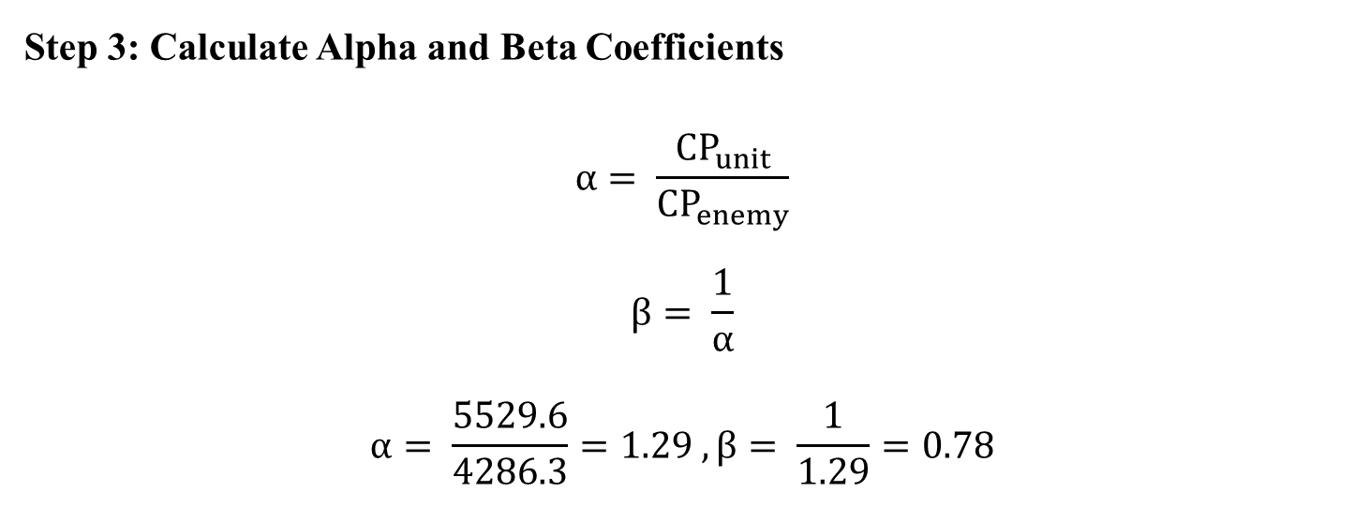
Battle Results for TDSS Feedback (Cont’d)
Step 3: Calculate Alpha and Beta Coefficients
$$α= \frac{{CP}_{unit}}{{CP}_{enemy}}$$
$$β= \frac{1}{α}$$
$$α= \frac{5529.6}{4286.3}=1.29 , β= \frac{1}{1.29}=0.78$$

Slide 51
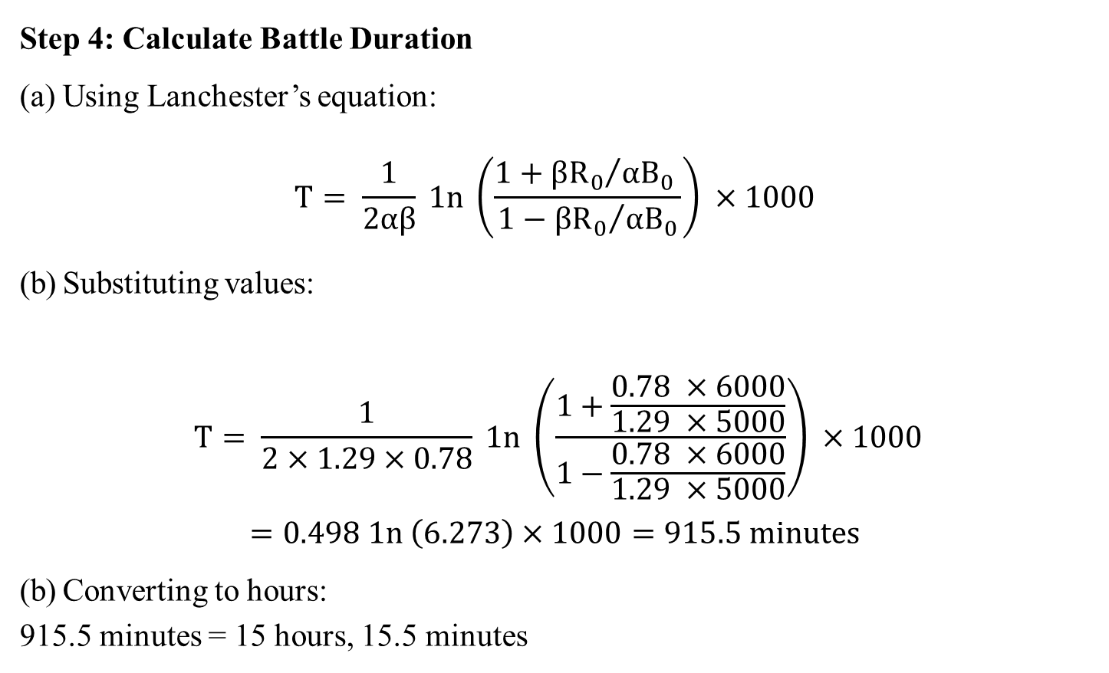
Battle Results for TDSS Feedback (Cont’d)
Step 4: Calculate Battle Duration
Using Lanchester’s equation:
$$T= \frac{1}{2αβ} 1n \left(\frac{1+{βR_{0}}/{αB_{0}} }{1−{βR_{0}}/{αB_{0}}}\right) ×1000$$
Substituting values:
$$T= \frac{1}{2×1.29×0.78} 1n \left(\frac{1+\frac{0.78 ×6000}{1.29 ×5000}}{1−\frac{0.78 ×6000}{1.29 ×5000}}\right) ×1000$$
$$=0.498 1n \left(6.273\right)×1000=915.5 minutes$$
Converting to hours:
915.5 minutes = 15 hours, 15.5 minutes

Slide 52
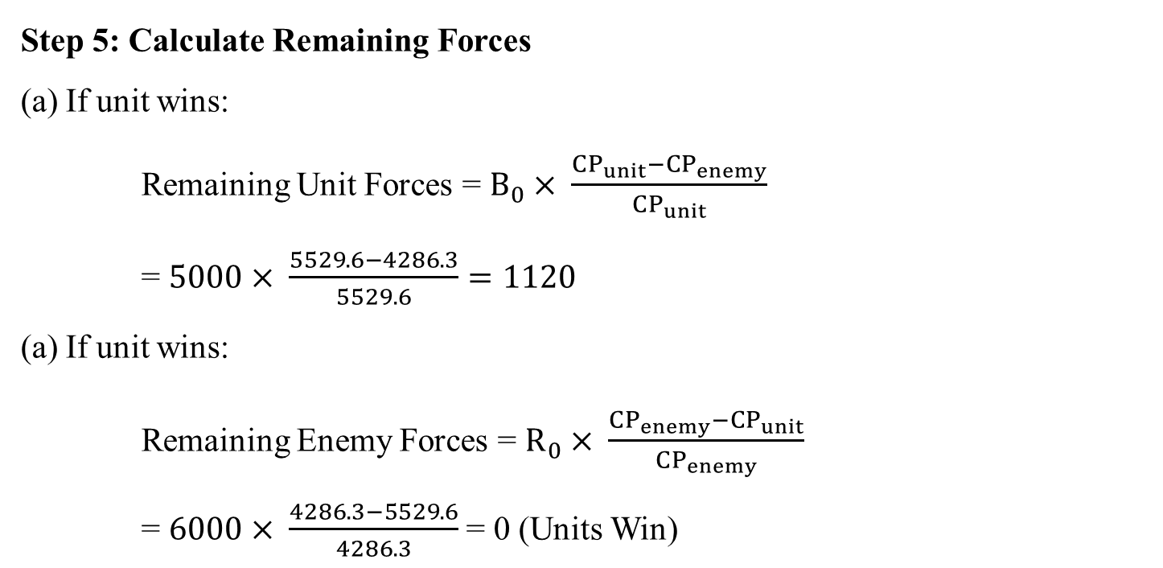
Battle Results for TDSS Feedback (Cont’d)
Step 5: Calculate Remaining Forces
If unit wins:
Remaining Unit Forces = $B_{0}× \frac{{CP}_{unit}−{CP}_{enemy}}{{CP}_{unit}}$
=$5000× \frac{5529.6−4286.3}{5529.6}=1120$
If unit wins:
Remaining Enemy Forces = $R_{0}× \frac{{CP}_{enemy}−{CP}_{unit}}{{CP}_{enemy}}$
=$6000× \frac{4286.3−5529.6}{4286.3}$ = 0 (Units Win)

Slide 53
Battle Results for TDSS Feedback (Cont’d)
Step 6: Summary of Battle Results
Result | Value
Battle Duration (Units win) | 15 hours, 15.5 minutes
Battle Duration (Enemy wins) | Not applicable (Units win)
Remaining Unit Forces | 1120 soldiers
Remaining Enemy Forces | 0 (enemy eliminated)
Battle Outcome | Victory for Units

Slide 54
Battle Results for TDSS Feedback (Cont’d)
Step 7: Most Dangerous Enemy Calculation
The formula for the Threat Score is:
Threat Score=(Manpower×0.3)+(Weapon Power×0.7)
Example Calculation
Let’s assume we have the following data for two enemies:
Enemy 1:
Manpower: 100
Weapon Type: "Rocket Launcher"
Ammo Amount: 50
Blast Radius: 2.5 (from blastRadiusMap)
Rate of Fire: 3 (from rateOfFireMap)
Enemy 2:
Manpower: 150
Weapon Type: "Machine Gun"
Ammo Amount: 200
Blast Radius: 1.0 (from blastRadiusMap)
Rate of Fire: 10 (from rateOfFireMap)

Slide 55
Battle Results for TDSS Feedback (Cont’d)
Step 7: Most Dangerous Enemy Calculation
Step 1: Calculate Weapon Power for Each Enemy
Enemy 1:
Weapon Power=Ammo Amount × Blast Radius × Rate of Fire Weapon Power=50×2.5×3=375
Enemy 2:
Weapon Power=200×1.0×10=2000
Step 2: Calculate Threat Score for Each Enemy
Enemy 1:
Threat Score = (Manpower×0.3) + (Weapon Power × 0.7 ) Threat Score=(100×0.3)+(375×0.7)=30+262.5=292.5
Enemy 2:
Threat Score=(150×0.3)+(2000×0.7)=45+1400=1445

Slide 56
Battle Results for TDSS Feedback (Cont’d)
Step 7: Most Dangerous Enemy Calculation
Step 3: Compare Threat Scores
Enemy 1 Threat Score: 292.5
Enemy 2 Threat Score: 1445
Enemy 2 has a significantly higher Threat Score (1445) compared to Enemy 1 (292.5). Therefore, Enemy 2 is identified as the most dangerous enemy and should be targeted first.

Slide 57
Implementation

Slide 58
Conclusion
This system supports an Automated Military Tactical Support System, designed to leverage advancements in Geospatial Information Systems (GIS) and algorithmic optimization to provide dynamic visualizations of weapon firing ranges and comprehensive engagement planning.
It also supports to automate the process of retrieving location data, measuring distances, visualizing weapon ranges, and calculating optimal engagement strategies, thereby providing military personnel with a robust tool for more precise and effective decision-making.

Slide 59
Benefits of the System
The system provides a streamlined process for analyzing geospatial data, calculating distances, and identifying the most suitable weapons for a given scenario. This enhances the decision-making speed and accuracy for military operations.
By integrating Google Hybrid Maps, UTM maps, and MGRS grids, the system offers precise and detailed mapping capabilities, allowing users to visualize and manage positional data effectively.
The use of local storage for map caching and integration with web APIs ensures the system can operate reliably in both offline and online environments, making it adaptable to various operational contexts.
With features such as drawing weapon firing ranges, calculating distances and bearings, and simulating battle results using Lanchester’s Square Law, the system allows users to predict and plan outcomes more effectively.
The implementation of the A* algorithm enables users to identify the most efficient routes for troop and equipment movement, avoiding obstacles and enhancing operational efficiency.

Slide 60
Limitation of the System
The system heavily relies on the accuracy of geospatial data from maps and APIs. Any errors or outdated data in the source can affect the precision of calculations and decision-making.
While the system supports web APIs for geospatial data and weapon information, it lacks real-time integration for dynamic battlefield updates, such as moving units or changing obstacles.
Although the system allows map caching for offline use, the availability of cached map tiles and data is limited to pre-downloaded regions, which may not cover all operational areas.
The use of Lanchester's Square Law provides a mathematical model for battle outcomes but may oversimplify complex battlefield dynamics, such as terrain effects or real-time unit interactions.
Pathfinding and obstacle avoidance using the A* algorithm may become computationally intensive in large-scale scenarios with numerous obstacles and units, potentially impacting performance.

Slide 61
References
Clausewitz, C. von. (1832). “On War”.
Defense Mapping Agency. (1989). “Technical Manual 8358.1: Datums, Ellipsoids, Grids, and Grid Reference Systems”.
Eccles, H. (1959). “Logistics in the National Defense”.
El-Gohary, M., & El-Rabbany, A. (2011). Applications of Geographic Information Systems (GIS) in Military Operations. “Proceedings of the 2011 International Conference on Military Communications and Information Systems (ICMCIS)” (pp. 1-6). IEEE.
Epstein, J. M. (1985). “The Calculus of Conventional War: Dynamic Analysis Without Lanchester Theory”. Brookings Institution.
Hale, M., & Davis, R. (2020). “The Role of Tactical Decision Support Systems in Modern Warfare”. Defense Technology Journal, 14(3), 213-225.

Slide 62
References (Cont’d)
Hart, P. E., Nilsson, N. J., & Raphael, B. (1968). “A Formal Basis for the Heuristic Determination of Minimum Cost Paths”. IEEE Transactions on Systems Science and Cybernetics, 4(2), 100–107.
Huang, B., & Liu, N. (2018). “Advances in Mobile Map Caching for Seamless Navigation”. Journal of Location-Based Services, 12(2), 89–102.
Karney, C. F. F. (2011). “Transverse Mercator with an accuracy of a few nanometers”. Journal of Geodesy, 85(8), 475–485.
LaValle, S. M. (2006). “Planning Algorithms”. Cambridge University Press.
Madhuri, R., & Radhakrishnan, M. (2020). “Flutter: A Modern Framework for Cross-Platform Mobile Application Development”. International Journal of Computer Applications, 175(9), 10-14.
NATO Standardization Office. (2017). “Glossary of Terms and Definitions (AAP-06)”.

Slide 63
References (Cont’d)
Pagonis, W. (1992). “Moving Mountains: Lessons in Leadership and Logistics from the Gulf War”.
Saaty, T. L. (1980). “The Analytic Hierarchy Process”. McGraw-Hill International.
Sharma, R., & Aggarwal, S. (2010). “Applications of Distance Measurement in Military Targeting”. Journal of Geospatial Science.
Tolk, A., Diallo, S. Y., & Wang, W. (2013). “Modeling and Simulation Support for System of Systems Engineering Applications”. Wiley.
U.S. Army. (2008). “Field Manual FM 3-22.9 Rifle Marksmanship M16-/M4-Series Weapons”.
U.S. Department of Defense. (2019). “Geospatial Intelligence: A Guide for Military Applications”. Department of Defense, Washington, D.C.

Slide 64
References (Cont’d)
For additional guidance and assistance contact NGA’s Office of GEOINT Sciences (SN), “Coordinate Systems Analysis Branch St. Louis, MO: 314-263-4171 (DSN 693-4171) Bethesda, MD: 301-227-3340 (DSN 287-3340)”. (2009)
"Deriving the haversine formula". (1999). Ask Dr. Math. April 20–21. Archived from the original on 20 January 2020.
http://codefiner.com/post/mb-tiles-specification-1-2-a-comprehensive-guide.
https://education.nationalgeographic.org/resource/geographic-information-system-gis/.
https://storymaps.arcgis.com/stories/842edf2b4381438b9a4edefed124775b.

Slide 65
Future Work
Seminar | Step of Research | Utilized software | Remark
1stSeminar | Background Theory and Literature Review, Proposed System Design for research work, Map Integration | Flutter, Web API | Done
2ndSeminar | Implementation and Data preparing | Motor Gun Weapon Specification | Done
3rdSeminar | Testing of Map with TDSS and Results | TDSS | Yet

Slide 66
Comments And Suggestions on First Seminar
စဉ် | အဆင့်/အမည် | ညွှန်ကြားချက် | လိုက်နာဆောင်ရွက် ချက်
၁ | ဒုမှူးကြီး ဇာနေလင်း | system ၏ process တစ်ခုစီအလိုက်ပေါ်လွင်အောင် flowchart ပြန်ဆွဲရန်။ မသမာသူလက်ထဲရောက်ရှိပါက အသုံးမပြုနိုင်အောင် security ပြုလုပ်ရန်။ | ဆောင်ရွက်ပြီးပါပြီ။
၂ | ဗိုလ်မှူး နေဖြိုး | Weapon Selection တွင် ကျည်ပေါက်ကွဲမှုဧရိယာအား ထည့်သွင်းတွက်ချက်ရန်။ | ဆောင်ရွက်ပြီးပါပြီ။

Slide 67
Comment & Suggestions?

Slide 68
Thank You

